Slide 1
Blacktown Chinese Christian Church
Welcome to Our English Service 27.04.2025
English Service 9:45 – 11:00 am
Worship Songs: Passage: Speaker: Topic: Response Song: Announcements and Closing Prayer Benediction
Desert Song 10000 Reasons A Thousand Hallelujahs Ruth 1:6-16 TBA TBA TBA

Slide 2
BCCC english service

Slide 3

Please keep all phones on silent

Slide 4
Desert Song
Brooke Ligertwood ©2008 Hillsong Music Publishing Australia CCLI Licence No. 5485849. CCLI Song number: 5060793

Slide 5
Verse 1
This is my prayer in the desert
When all that's within me feels dry
This is my prayer in my hunger and need
My God is the God who provides

Slide 6
Verse 2
This is my prayer in the fire
In weakness or trial or pain
There is a faith proved of more worth than gold
So refine me, Lord, through the flame

Slide 7
Chorus
I will bring praise
I will bring praise
No weapon formed against me shall remain

Slide 8
Chorus
I will rejoice
I will declare
God is my victory and He is here

Slide 9
Verse 3
And this is my prayer in the battle
When triumph is still on its way
I am a conqueror and co-heir with Christ
So firm on His promise I'll stand

Slide 10
Chorus
I will bring praise
I will bring praise
No weapon formed against me shall remain

Slide 11
Chorus
I will rejoice
I will declare
God is my victory and He is here

Slide 12
Bridge
All of my life, in every season
You are still God, I have a reason to sing
I have a reason to worship
(4x)

Slide 13
Chorus
I will bring praise
I will bring praise
No weapon formed against me shall remain

Slide 14
Chorus
I will rejoice
I will declare
God is my victory and He is here

Slide 15
Chorus
I will bring praise
I will bring praise
No weapon formed against me shall remain

Slide 16
Chorus
I will rejoice
I will declare
God is my victory and He is here

Slide 17
Verse 4
This is my prayer in the harvest
When favor and providence flow
I know I'm filled to be emptied again
The seed I've received I will sow

Slide 18
10000 Reasons (Bless The Lord)
Jonas Myrin, Matt Redman © 2012 2011 Atlas Mountain Songs (Admin. by SHOUT! Music Publishing Australia) CCLI Licence No. 5485849 . CCLI Song number: 6016351

Slide 19
Chorus
Bless the Lord oh my soul
Oh my soul
Worship His Holy name

Slide 20
Chorus
Sing like never before
Oh my soul
I'll worship Your Holy name

Slide 21
Verse 1
The sun comes up
It's a new day dawning
It's time to sing Your song again

Slide 22
Verse 1
Whatever may pass
And whatever lies before me
Let me be singing
When the evening comes

Slide 23
Chorus
Bless the Lord oh my soul
Oh my soul
Worship His Holy name

Slide 24
Chorus
Sing like never before
Oh my soul
I'll worship Your Holy name

Slide 25
Verse 2
You're rich in love
And You're slow to anger
Your name is great
And Your heart is kind

Slide 26
Verse 2
For all Your goodness
I will keep on singing
Ten thousand reasons
For my heart to find

Slide 27
Chorus
Bless the Lord oh my soul
Oh my soul
Worship His Holy name

Slide 28
Chorus
Sing like never before
Oh my soul
I'll worship Your Holy name

Slide 29
Verse 3
And on that day
When my strength is failing
The end draws near
And my time has come

Slide 30
Verse 3
Still my soul will
Sing Your praise unending

Slide 31
Verse 3
Ten thousand years
And then forevermore
Forevermore

Slide 32
Chorus
Bless the Lord oh my soul
Oh my soul
Worship His Holy name

Slide 33
Chorus
Sing like never before
Oh my soul
I’ll worship your holy name

Slide 34
Chorus
Bless the Lord oh my soul
Oh my soul
Worship His Holy name

Slide 35
Chorus
Sing like never before
Oh my soul
I’ll worship your holy name

Slide 36
Tag
Lord I’ll worship your holy name
I’ll worship your holy name

Slide 37
Outro
Sing like never before
Oh my soul
I'll worship Your Holy name
I'll worship Your Holy name

Slide 38
A Thousand Hallelujahs
Brooke Ligertwood, Phil Wickham, Scott Ligertwood © 2022 City and Vine Music Publishing International (Admin. by City and Vine Music Publishing) Phil Wickham Music (Admin. by Crossroad Distributors Pty. Ltd.) Simply Global Songs (Admin. by Crossroad Distributors Pty. Ltd.) CCLI Licence No. 5485849 . CCLI Song number: 7190270

Slide 39
Verse 1
Who else would rocks cry out to worship?
Whose glory taught the stars to shine?
Perhaps creation longs to have the words to sing
But this joy is mine

Slide 40
Chorus
With a thousand hallelujahs
We magnify Your name
You alone deserve the glory
The honor and the praise

Slide 41
Chorus
Lord Jesus
This song is forever Yours
A thousand hallelujahs
And a thousand more

Slide 42
Verse 2
Who else would die for our redemption?
Whose resurrection means I’ll rise?
There isn’t time enough to sing of all You’ve done
But I have eternity to try

Slide 43
Chorus
With a thousand hallelujahs
We magnify Your name
You alone deserve the glory
The honor and the praise

Slide 44
Chorus
Lord Jesus
This song is forever Yours
A thousand hallelujahs
And a thousand more

Slide 45
Bridge
Praise to the Lord
To the lamb
To the King of Heaven

Slide 46
Bridge
Praise for He rose
Now He reigns
We will sing forever

Slide 47
Bridge
Praise to the Lord
To the lamb
To the King of Heaven

Slide 48
Bridge
Praise for He rose
Now He reigns
We will sing forever

Slide 49
Chorus
With a thousand hallelujahs
We magnify Your name
You alone deserve the glory
The honor and the praise

Slide 50
Chorus
Lord Jesus
This song is forever Yours
A thousand hallelujahs
And a thousand more

Slide 51
Bridge
Praise to the Lord
To the lamb
To the King of Heaven

Slide 52
Bridge
Praise for He rose
Now He reigns
We will sing forever

Slide 53
Chorus
With a thousand hallelujahs
We magnify Your name
You alone deserve the glory
The honor and the praise

Slide 54
Chorus
Lord Jesus
This song is forever Yours
A thousand hallelujahs
And a thousand more

Slide 55

Bible reading

Slide 56
Ruth 1:6-16 (NIV)
⁶ When Naomi heard in Moab that the Lord had come to the aid of his people by providing food for them, she and her daughters-in-law prepared to return home from there. ⁷ With her two daughters-in-law she left the place where she had been living and set out on the road that would take them back to the land of Judah.

Slide 57
Ruth 1:6-16 (NIV)
⁸ Then Naomi said to her two daughters-in-law, “Go back, each of you, to your mother’s home. May the Lord show you kindness, as you have shown kindness to your dead husbands and to me. ⁹ May the Lord grant that each of you will find rest in the home of another husband.”
Then she kissed them goodbye and they wept aloud

Slide 58
Ruth 1:6-16 (NIV)
¹⁰ and said to her, “We will go back with you to your people.”
¹¹ But Naomi said, “Return home, my daughters. Why would you come with me? Am I going to have any more sons, who could become your husbands?

Slide 59
Ruth 1:6-16 (NIV)
¹² Return home, my daughters; I am too old to have another husband. Even if I thought there was still hope for me—even if I had a husband tonight and then gave birth to sons— ¹³ would you wait until they grew up? Would you remain unmarried for them? No, my daughters. It is more bitter for me than for you, because the Lord’s hand has turned against me!”

Slide 60
Ruth 1:6-16 (NIV)
¹⁴ At this they wept aloud again. Then Orpah kissed her mother-in-law goodbye, but Ruth clung to her.
¹⁵ “Look,” said Naomi, “your sister-in-law is going back to her people and her gods. Go back with her.”

Slide 61
Ruth 1:6-16 (NIV)
¹⁶ But Ruth replied, “Don’t urge me to leave you or to turn back from you. Where you go I will go, and where you stay I will stay. Your people will be my people and your God my God.

Slide 62
Scripture quotations taken from The Holy Bible, New International Version® NIV®
Copyright © 1973, 1978, 1984, 2011 by Biblica, Inc.
Used with permission. All rights reserved worldwide.

Slide 63
Announcements

Slide 64





Account name: Blacktown Chinese Christian Church
Account number: 4216 50263
Offering
BSB: 112 - 879
Please put in "offering" as the reference
The offering box is available at the back of the hall

Slide 65
Prayer points

Slide 66
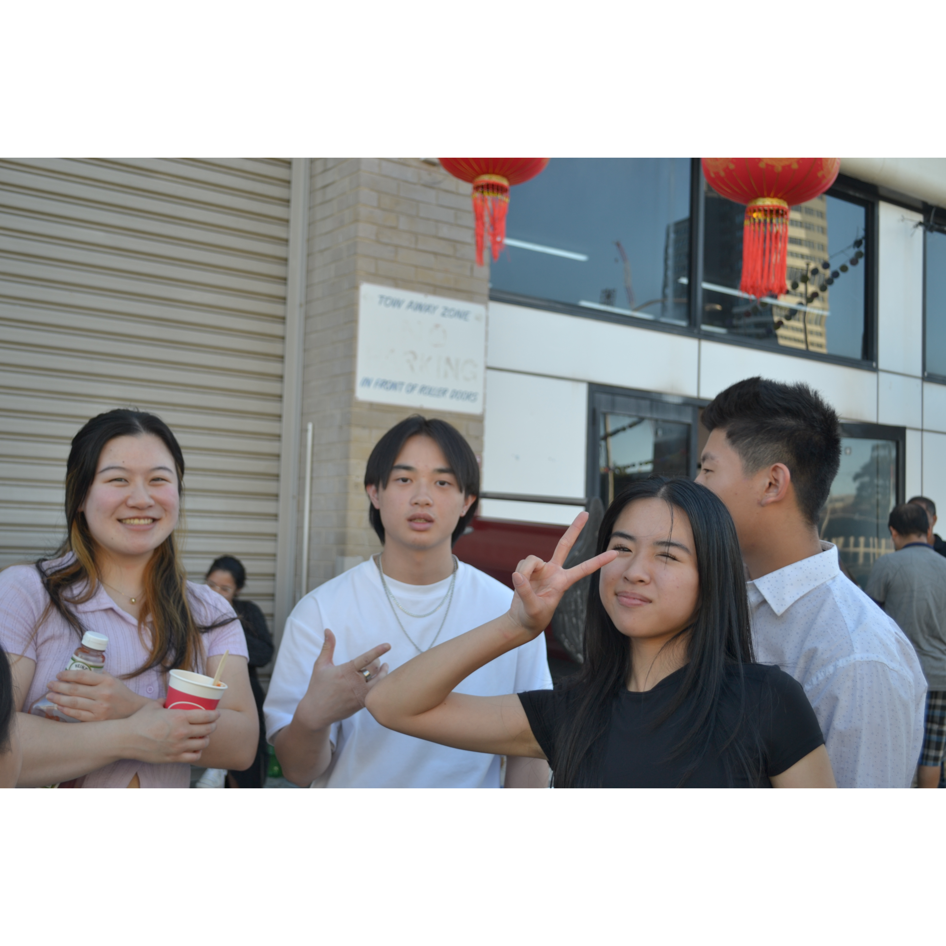
Mingle time!

